Slide 1
Machine Learning: Where We’re at, But More Importantly, Where We’re Going…
Presented By:
Alistair Garrison
Director of Accessibility Research
CSUN 2018 Assistive Technology Conference
March 21, 2018

Slide 2

Introduction
Alistair Garrison:
Director of Accessibility Research
17 years experience - auditing applications (websites, mobile), and developing A11y testing tools
W3C/WAI – Participant

Slide 3
Summary…
It's been an exciting year!
But, it's just the tip of the iceberg!

Slide 4
Last year…
Introduced the concept that: We were artificially limiting ourselves by what we believe can only be tested by a human e.g. only 25% of things…
Generally, because:
Our tests were not broken down sufficiently into properly atomic tests – so expert human judgement was still inherently, but really artificially, relied upon; and
We didn’t really properly understand what Machines-that-learn could do in our field – because, we ourselves had just started to learn about them…

Slide 5
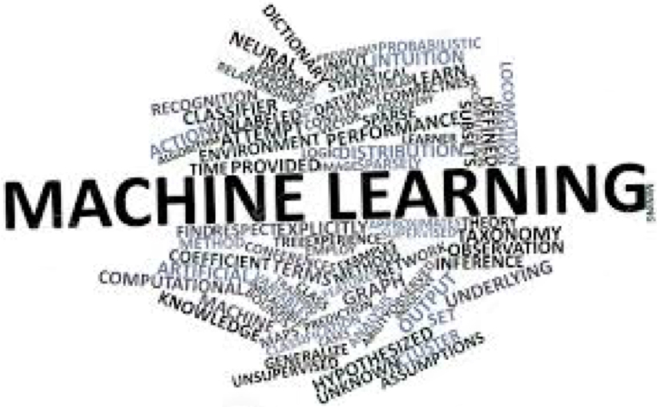
Last year… (2)
In the talk, we described Machine Learning…
Massive field within Computer Science Inc.
Neural networks;
Deep learning;
Enables computers to do things that they have not been explicitly programmed to do.

Slide 6
Last year… (3)
And, we introduced fields within ML that might be of use to use in terms of pushing the boundaries of Accessibility testing…
Classification – focusing on supervised learning (spam filters);
Natural Language Processing (NLP);
Image Recognition (inc. OCR);
Image Similarity Comparison;

Slide 7
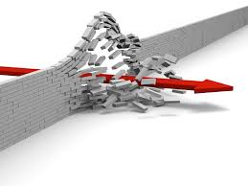
And we left with, going forward, we need to:
Ensure that we don’t limit ourselves to what “we believe can only be tested by humans”.
Look to create more and more atomic tests;
To enable things to be determined with less and less reliance on human skills / expertise.
Look to collect vast numbers of examples of things – in ML such collections are called Corpora.
Look to take / apply more and more thinking from Machine Learning.

Slide 8
And, that’s what we’ve been doing…
Growing understanding of topics within the field of Artificial Intelligence (AI) and Machine Learning (ML);
Also, to encompass the capabilities of Neural Networks in Narrow AI;

Slide 9
FYI – Neural Networks…
Neural Network: An artificial neural network is an interconnected group of nodes, akin to the vast network of neurons in a brain.
Neural networks learn things by a feedback process called back-propagation = comparing the output a network produces with the output it was meant to produce, and using the difference between them to modify the weights of the connections between the nodes in the network.
Source: https://en.wikipedia.org/wiki/Artificial_neural_network
Notes:
Source: https://en.wikipedia.org/wiki/Artificial_neural_network

Slide 10
FYI – Narrow AI…
Narrow AI: a high-functioning system that replicates – and perhaps surpasses -- human intelligence in very focused tasks e.g. DeepMind AlphaGo.

Slide 11
Then using our understanding as a lens…
We’ve been looking at the core tasks within our core activities, such as the:
Provision of Accessibility Testing;
Provision of Accessibility Solutions.
To determine:
What AI/ML can replace;
What AI/ML can better support…

Slide 12
And, as such…
We’ve been discovering all about…
The major platforms that support Machine Learning;
The data needed to support Machine Learning;
The re(processes) that we’ll need to support Machine Learning;
And, of course, loads more…

Slide 13
However…
All of the above can still be seen, by some, as only “merely interesting”, or a “fad”...
A “not in our industry” mentality can exist with regard to the use of Machine Learning…

Slide 14
That is…
Unless it is presented in the context of where we’re at, and more importantly, where we’re going…
In what is being described by some as a 4th industrial revolution – brought about through AI, and machines that learn…

Slide 15
The big picture…
Relates to core activities within a business; rather than jobs; or whole industry sectors.
Is presented in terms of a time-line…
We do it all…
Machines assist Us
We assist Machines
Machines do it all
Transition

Slide 16
We can say this, as this pattern is not unique to an industry…
Health: An artificial intelligence computer programme can pinpoint bowel cancer in less than a second, experts say. The Narrow AI was trained against more than 30,000 images, and can now correctly identify up 94% of cancers.
Replacing a task that was previously done by highly trained clinicians.

Slide 17
We can say this, as this pattern is not unique to an industry… (2)
Law: Last year over 100 lawyers from London law firms competed against an artificial intelligence program called Case Cruncher Alpha.
The humans and AI were given the basic facts of hundreds of PPI (payment protection insurance) mis-selling cases and asked to predict whether the Financial Ombudsman would allow a claim.
In all, they submitted 775 predictions and the computer won hands down, with Case Cruncher getting an accuracy rate of 86.6%, compared with 66.3% for the lawyers.
Source: BBC: http://www.bbc.co.uk/news/technology-41829534

Slide 18
We can say this, as this pattern is not unique to an industry… (3)
Journalism: In 2017, research revealed that thousands of stories a month are now being produced in European newsrooms with the help of algorithms.
The survey, from Oxford University's Reuters Institute of Journalism, found that many publishers are using automation to release interesting data quickly - from election results to official figures on social issues.
Source: BBC: http://www.bbc.co.uk/news/technology-41829534

Slide 19
We can say this, as this pattern is not unique to an industry… (4)
Games: In a major breakthrough for artificial intelligence, AlphaGo Zero took just three days to master the ancient Chinese board game of Go...
With no human help…

Slide 20
Why… The drivers are clear…
Reducing the unit cost (time + money) per task, or micro-task…
And, why I started to build tools (over 20 years ago)… because ML can help do the “boring stuff”…

Slide 21
When?…
I recently read a book in which the authors showed each industrial revolution as a classic “S” curve…
Slow to start – with a small number of companies able to reap benefits;
Moving through a transition – when broad take-up is possible by all;
Then full burn…
Here!
Source: What To Do When Machines Do Everything - B01N7UAGFJ

Slide 22
Machine Learning is now readily available…
Google’s Tensorflow (Open-sourced);
Amazon’s AWS – SageMaker platform…
IBM’s Watson…
Etc… Coupled with:
The cost of computing getting cheaper year-on-year;
The cloud power available to compute stuff growing year-on-year…

Slide 23
So, moving into transition…
Excuse me… What’s that?
We continuing to determine (in terms of core tasks within core activities) :
What ML can replace;
What it can better support…
But, most importantly of all we’ve now understood that we need to seek to ask humans the right questions ASAP; so we can (machine) learn from their responses.

Slide 24
What we’re seeing now…
Certain A11y tests move from being deterministic, to probabilistic…
Probabilistic: There’s a (high / %) likelihood that…
Deterministic: It’s definitely that…

Slide 25
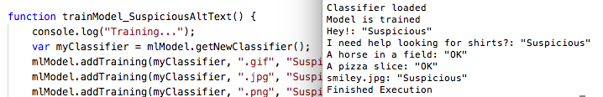
Example test – created with a classifier…

Slide 26
But, more exciting…
Show me the Machine Learning future for A11y!
But, still a little “predictiony”…

Slide 27
What we’ll see in the near future…
The whole testing engine = a narrow AI neural network…
The remediation engine = a narrow AI neural network…
Accessibility testing as a whole becoming probabilistic, rather than deterministic…
Supervised-learning:
Domain expertise will get drawn into the creation of the training Corpora needed by the Machine Learning tools…
Users being asked to make determinations behalf of machines – e.g. Mechanical Turk.

Slide 28
And, what we’ll see in the future…
The whole testing engine = a narrow AI neural network…
The remediation engine = a narrow AI neural network…
Self-learning – removing the need for supervised learning.
But, requiring loads and loads of “Analytics” data…

Slide 29
Is this realistic… well…
Quote from Bill Gates:
“We always overestimate the change that will occur in the next two years and underestimate the change that will occur in the next ten. Don't let yourself be lulled into inaction.”

Slide 30
So, what happens when Machines do all the a11y testing / fixing…
It will be practically free…
Test / live fix will be practically instantaneous…
Test + Fix coverage grows organically with exposure (regardless of technology)…
Accessibility testing as a whole is probabilistic, rather than deterministic…
Accessibility Standards?

Slide 31
What of Accessibility Standards?
Will they simply be redundant in an age were a Machine is able to recognise and directly fix any issues an individual might be having with an interface???
We’re starting to deal with this already…
WAI_ACT Working Group was looking to prescribe how tests are written. However, the point was raised that if some tests will be trained, rather than written – and there’s no way to prescribe the weightings which will be applied to nodes in a Neural Network – unless we all use the same Neural Network…

Slide 32
Ways to deal with it…
Break the machines – Luddites…
Head in sand… Not for us…
Or – simply embrace it… as others in your industry are…

Slide 33
Finally…
I should note that this is also happening in every sector of every industry…
In our industry (Accessibility Testing / Remediation), we have to think about what other industries might impact our core offerings
For example:
What if AI-based Chatbots replace user interfaces?
What if Assistive Technologies start to identify content by vision?
Etc…

Slide 34
Questions?

Slide 35




Thank You!
Contact Us
Alistair Garrison alistair.garrison@levelaccess.com
Follow Us
@ LevelAccessA11y
Level-Access
LevelAccessA11y
Level Access Blog
Slide Deck Available for Download at: https://www.levelaccess.com/csun18/

